Slide 1
Introduction to Computers for Engineers: Recitation #3

Slide 2
Learning Objectives
Understand the use of logical and comparative statements
Understand the structure of if/else/elseif statements
Understand how to use if/else/elseif structures and logical/comparative statements to have your program make decisions via branching
Understand how you can use a visualization to help you figure out how a program should branch
Notes:
Time Expectations:
Attendance – 5 min
Review Rec 2 Activity 4 – 10 min
Activity 1 – 10 min
Activity 2 – 15 min
Example – 10 min
Activity 3 – 10 min
Activity 4 – 15 min

Slide 3
Logical and Comparative Operators
Operator | Syntax | True When
AND | A&&B | A and B are both true
OR | A||B | A, B, or both A and B are true
NOT | ~A | A is false
Equal To | X == Y | X and Y have the same value
NOT Equal To | X ~= Y | X and Y have different values
Greater Than | X > Y | X has a higher value than Y
Less Than | X < Y | X has a lower value than Y
Greater Than OR Equal To | X >= Y | X has a higher or equal value to Y
Less Than OR Equal To | X <= Y | X has a lower or equal value to Y

Slide 4
Activity 1: Warm-up
Let’s get used to conditional statements!
Write a function called recitation3 that takes 2 inputs, x and y:
Has 1 output, z
When x is 0, z should be 0
Otherwise, when y is 0, z should be 1
Otherwise, z should be 2
Discuss: How many test cases should you write?
Discuss: What values might be most useful in your test cases?

Slide 5
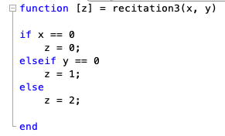
Activity 1: Solution

Slide 6
Activity 2: Divide and Solve
Team 1 Code:
Team 2 Code:
Write a function team1 that takes 2 inputs, x and y
Has 1 output, z
When both x and y are positive, and x is greater than y, z should be 4
When both x and y are positive and x is less than or equal to y, z should be 3
When both x and y are negative, and x is greater than y, z should be 2
When both x and y are negative, and x is less than or equal to y, z should be 1
Otherwise, z should be 0
Write a function team2 that takes 2 inputs, x and y
Has 1 output, z
When x and y have different signs, z should be 0
When both x and y are negative, and y is greater than or equal to x, z should be 1
When both x and y are negative, and y is less than x, z should be 2
When both x and y are positive, and y is greater than or equal to x, z should be 3
Otherwise, z should be 4
As a whole team, come up with test cases. Use the same test cases for both programs. What are the results of these tests?

Slide 7
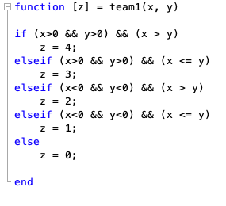
Activity 2: Solution
Team 1 Code:
Write a function team1 that takes 2 inputs, x and y
Has 1 output, z
When both x and y are positive, and x is greater than y, z should be 4
When both x and y are positive and x is less than or equal to y, z should be 3
When both x and y are negative, and x is greater than y, z should be 2
When both x and y are negative, and x is less than or equal to y, z should be 1
Otherwise, z should be 0
As a whole team, come up with test cases. Use the same test cases for both programs. What are the results of these tests?

Slide 8
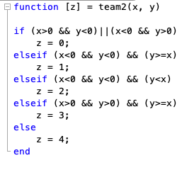
Activity 2: Solution
Team 2 Code:
Write a function team2 that takes 2 inputs, x and y
Has 1 output, z
When x and y have different signs, z should be 0
When both x and y are negative, and y is greater than or equal to x, z should be 1
When both x and y are negative, and y is less than x, z should be 2
When both x and y are positive, and y is greater than or equal to x, z should be 3
Otherwise, z should be 4
As a whole team, come up with test cases. Use the same test cases for both programs. What are the results of these tests?

Slide 9
Example: Train Cars
We are writing a program as a pre-screener for approving designs for train cars. Different systems use different track widths, but we want a program that will enforce the following general rules for us:
Train cars must be as wide as the train tracks
Train cars cannot be more than 5 feet wider than the train tracks
Train cars must be more than twice as long as they are wide
Train cars cannot exceed 50 feet

Slide 10
Example – Train Cars – Decision Space
Car length
Not OK
50 ft
OK
Car width x2
Car width
Track width
Track width + 5

Slide 11
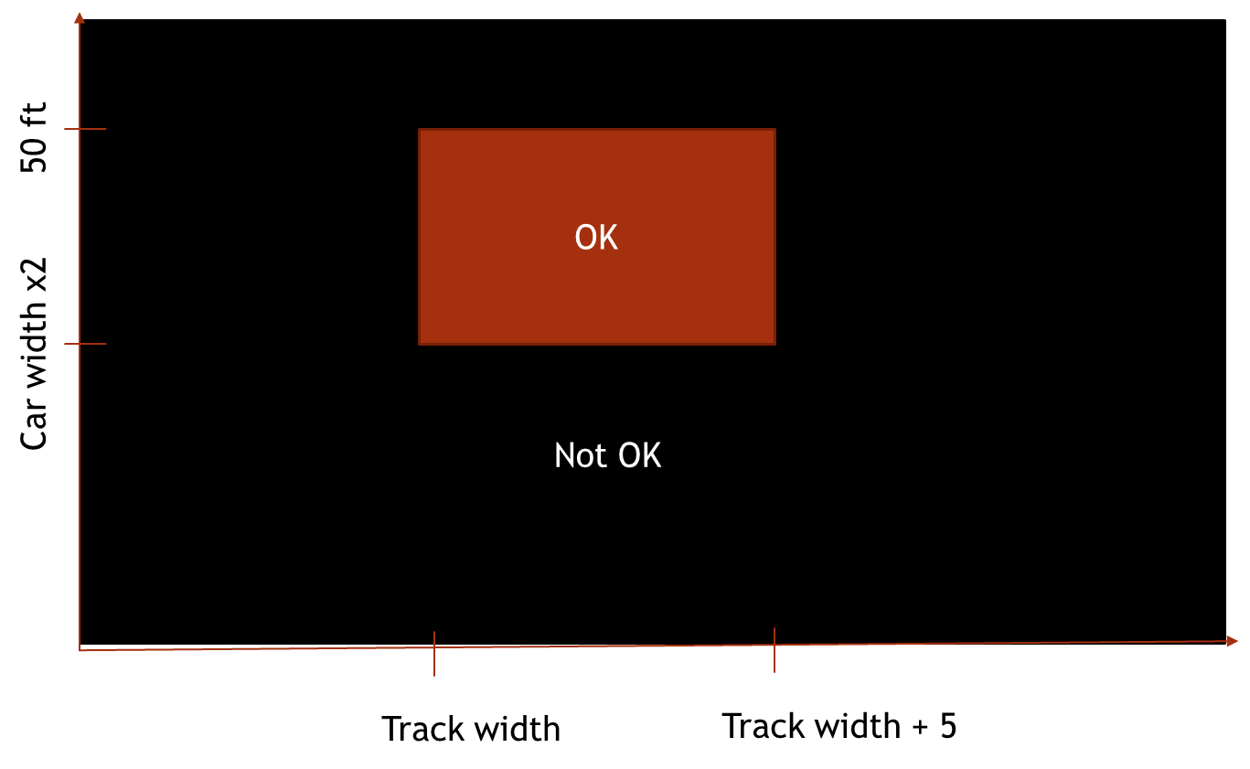
Example – Train Cars – Method 1 – Rejection Criteria
function ok = trainCars(trackW,carW,carL)
if carL > 50
ok = false;
elseif carL < carW*2
ok = false;
elseif carW < trackW
ok = false;
elseif carW > trackW + 5
ok = false;
else
ok = true
end

Slide 12
Example – Train Cars – Method 2 – Acceptance Criteria
function ok = trainCars(trackW,carW,carL)
if carL <= 50 && carL >= carW*2...
&&carW >= trackW && carW <= trackW+5
ok = true;
else
ok = false
end

Slide 13
Activity 3: Visualizing if-else statements
Let’s say we are calculating postage rates for packages
We want to charge for both weight and volume
$3.00 per kilogram
$1.00 per liter (0.001 cubic meter)
We also want surcharges
$10.00 if the item weighs more than 5 kg
$8.00 if the item has a volume of more than 20 liters (0.02 cubic meters)
Think about the boundaries of this space based on different price equations
Use the whiteboard
Try to draw a 2D chart of regions where:
The package is neither overweight or oversized
The package is oversized
The package is overweight
The package is both overweight and oversized
Discuss: When should you use > or < vs >= or <= to differentiate between regions?

Slide 14
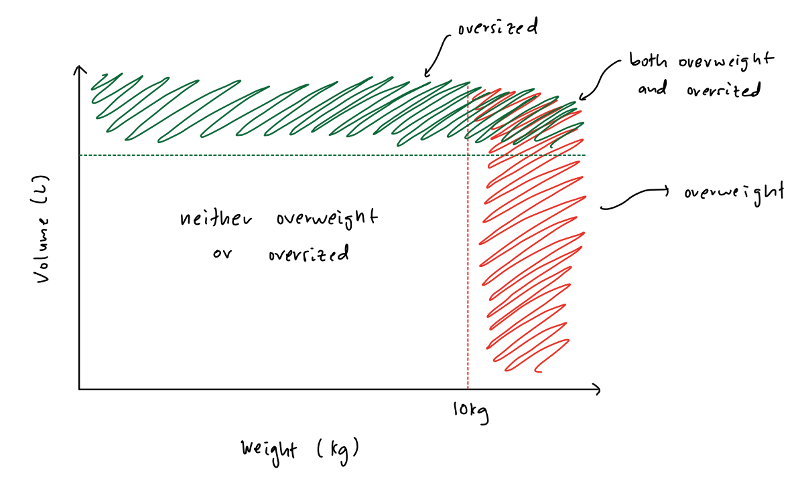
Activity 3: 2D Visualization

Slide 15
Activity 4: Implementation
Translate your charts into code!
Create a new function called computePostage that calculates postage given inputs of weight and volume
How does the image you created translate into code?
Which comparative operators did you use?
How many different branches (if/elseif/else keywords) do you need?
Come up with test cases within your group.
Discuss: What particular values did you want to test and why?

Slide 16
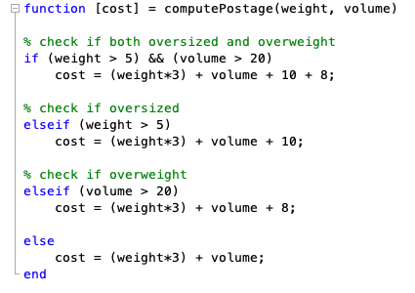
Activity 4: Solution

